Slide 1

Sample deployment diagram

Slide 2



Azure virtual network
HDInsight subnet
Zookeeper nodes
Worker nodes
Master
nodes
HADOOP
HDInsight service
gateway
Edge
node
[https]

Slide 3
What needs replication?

Slide 4
What’s in the cluster and what needs replication to DR?
HDFS
Business/master/ reference data
Services RDBMS
Data schema/metadata, users, RBAC policies, audit logs, batch job history etc
HDFS encryption keys
Ranger KMS database
DEPLOY TO DR
REPLICATE TO DR
Service conf
Security conf
Applications
Logs
Data
App. logs
Service logs
Transient data
Non-critical data
DISREGARD

Slide 5
Open-Source Replication configuration
Typical options for Hadoop & architectural considerations

Slide 6
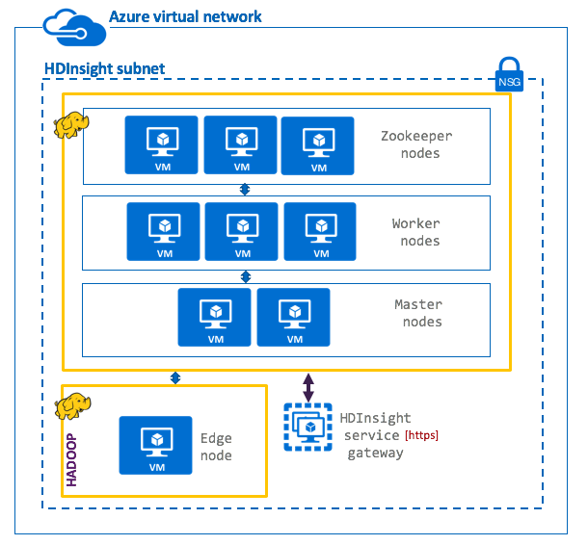

Option 1: Active-hot standby with dual ingest
Active
Hot standby
Ingest
Ingest
Process
Process
Publish
Publish
Primary datacenter
Secondary datacenter
Synchronization validation
RPO
Low
Applications/integration processes write to both clusters
Both clusters run identical batch jobs
Standby cluster is offline for reads by applications and end users
Synchronization tasks need to be run to ensure clusters are in sync
RTO
None
Cost
High
Its also not uncommon to have the hot standby used for non-critical workloads like adhoc exploratory analytics by data analysts, for reporting

Slide 7
Option 2: Active- cold standby with batch replication
Active
Cold standby
Ingest
Replication
Process
Publish
Primary datacenter
Secondary datacenter
Synchronization validation
Applications write to active-primary ONLY
Replication to DR cluster is incremental, batch, scheduled
Synchronization tasks need to be run to ensure clusters are in sync
Its is not uncommon to have a storage dense, compute light DR cluster for cost optimization
Only curated data is replicated
No batch processes are run
Medium
RPO
RTO
Medium
Cost
High

Slide 8




Option 3: Active-DR on demand
Active
DR- Cloud Storage
Ingest
Replication
Process
Publish
Provisions cluster ONLY when DR protocol is initiated
Synchronization validation
RPO
Highest
Applications write to active-primary cluster, no DR cluster provisioned
Replication utilities synchronize data and metastore to cloud storage in DR datacenter
Administrator provisions cluster on-demand in DR datacenter
Synchronization tasks need to be run to ensure clusters are in sync
RTO
Highest
Cost
Lowest
Effort
Highest

Slide 9


Option 4: Active-Active with multi-master – made possible by WANdisco
Active
Active
Ingest
Ingest
Apps/users routed to nearest cluster
Process
Process
Apps/users routed to nearest cluster
Publish
Publish
Datacenter 1
Datacenter 2
Synchronization validation
RPO
Lowest
Applications/integration processes write to/read from nearest cluster clusters
Both clusters run identical batch jobs
Synchronization tasks need to be run to ensure clusters are in sync
WANdisco fusion supports automated metadata replication (sync) and data replication (async), scheduling, monitoring, alerting, bandwidth throttling and more
RTO
None
Cost
Highest

Slide 10
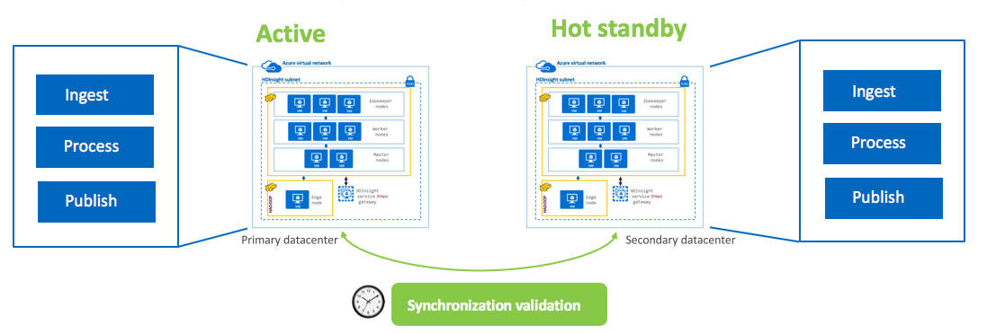
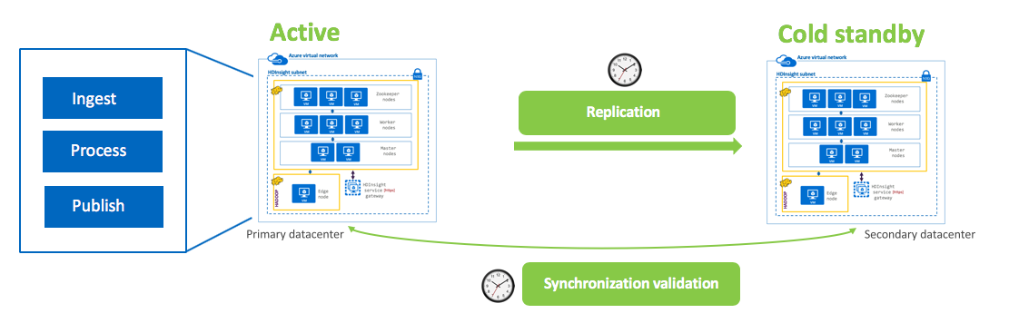
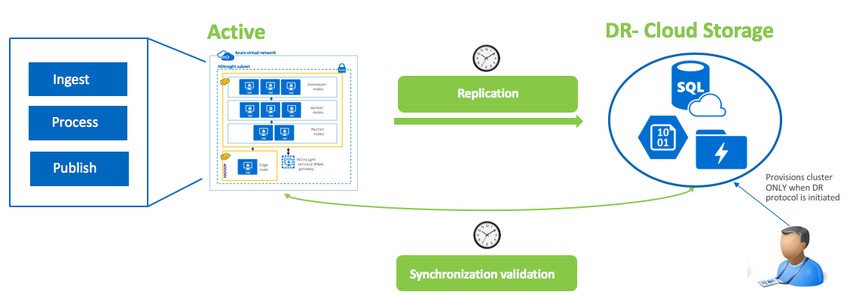
Configuration options | RPO | RTO | Cost | Effort
 | Low/ None | Low/ None | High | High
 | Medium | Medium | High | High
 | Highest | Highest | Lowest | Highest
1. Active-Hot standby with dual ingest & processing
2. Active-Cold standby with batch replication
3. Active-Provision DR cluster on-demand

Slide 11
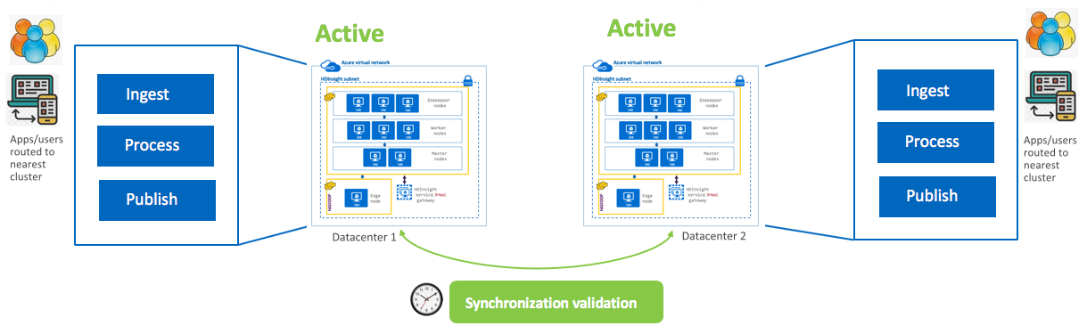
Configuration options | RPO | RTO | Cost | Effort
 | Lowest/ None | Lowest/ None | Highest | Lowest
4. Active-Active with multi-master, through WANdisco

